Slide 1

MATH CONCEPTS
(REVIEW )
MODULE 2

Slide 2
LETS REVIEW CONCEPTS YOU MIGHT HAVE FORGOTTEN SUCH AS
Math notation: Sigma
Functions and function family
Factorial operations
Mean, Expected Value, Median and Mode
Data Squad | Statistics Introdution

Slide 3
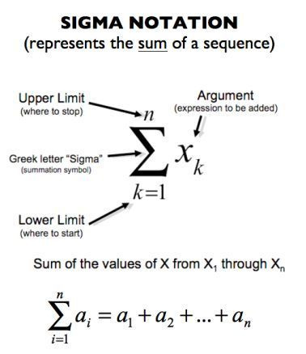
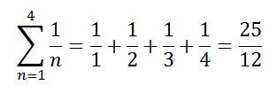
SIGMA
Data Squad | Statistics Introdution
Notes:
Talk about:
lower-upper limit
Properties:
-> sig(4x) = 4*sig(x)
-> sig(x + y) = sig(x) + sig(y)
Notation:
1/n * sig(xn)
Known results:
sig(1/i), i/2=0 -> 1
sig(1/i) -> inf
sig(i) = n(n+1)/2
Exercise:
sig(4k + 3k+ 2), i=1->n

Slide 4
SIGMA
Data Squad | Statistics Introdution
Notes:
Explain the concept of Suming from one point to the other

Slide 5
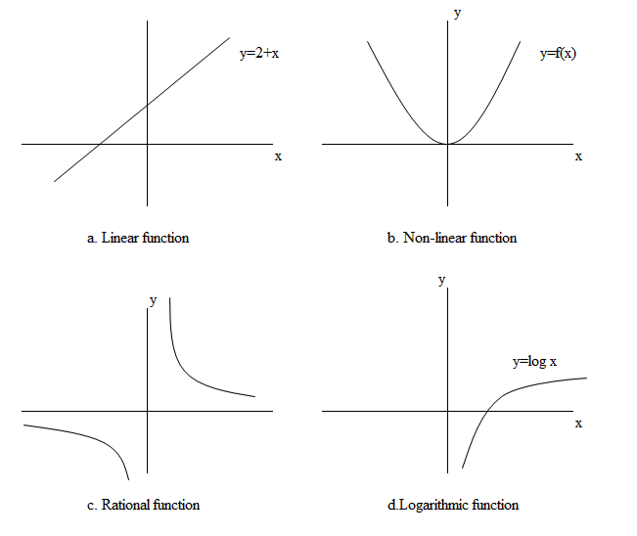
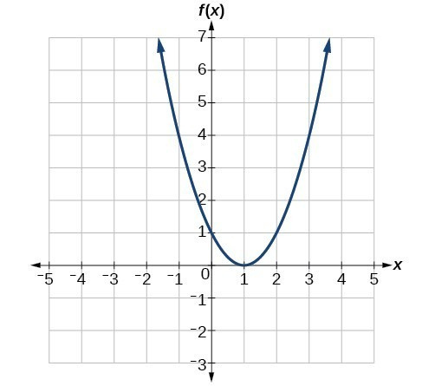
FUNCTIONS AND
FUNCTIONS FAMILY
y= a*x + b
y= ax^2 + bx + c
f(x) = (x-1)^2
y = (x-1)^2
y= 1/x
Data Squad | Statistics Introdution
Notes:
Exercise for (x-1)^2:
x=0 -> y=1
x= -1 -> y=4
x= 2 -> y=1

Slide 6
FUNCTIONS AND
FUNCTIONS FAMILY
Data Squad | Statistics Introdution

Slide 7
FACTORIALS AND WHY THEY ARE USEFULL...
I'll put 12 papers in a basket to select randomly the order for the presentations...
How many possible outcomes there are?
Factorial:
n! = n x (n-1) x (n-2) x ... x 1
...
Andrei
Lili
Sofia
Itua
Gerard
12! = 12 x 11 x 10 x 9 x 8 x 7 x 6 x 5 x 4 x 3 x 2 x 1 = 479,001,600.
Data Squad | Statistics Introdution

Slide 8
FACTORIALS AND WHY THEY ARE USEFULL...
Data Squad | Statistics Introdution

Slide 9
FACTORIALS AND WHY THEY ARE USEFULL...
What if I only wanted 3 students?
Factorial:
n! = n x (n-1) x (n-2) x ... x 1
What I want -> 9 x 8 x 7
Andrei
Lili
Sofia
Data Squad | Statistics Introdution

Slide 10
FACTORIALS AND WHY THEY ARE USEFULL...
What if I only wanted 3 students?
Factorial:
n! = n x (n-1) x (n-2) x ... x 1
What I want -> 9 x 8 x 7
9! = 9 x 8 x 7 x 6 x 5 x 4 x 3 x 2 x 1
6! = 6 x 5 x 4 x 3 x 2 x 1
9x8x7 = 9! / 6!
Andrei
Lili
Sofia
Wanna know more on this?
Research PERMUTATIONS, COMBINATIONS and ARRANGEMENTS
Data Squad | Statistics Introdution

Slide 11

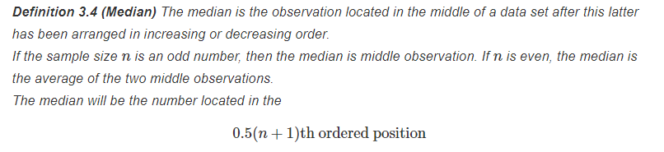


MEASURES OF CENTRAL TENDENCY AND LOCATION
ARITHMETIC MEAN
MEDIAN
MODE
Data Squad | Statistics Introdution

Slide 12
MEASURES OF CENTRAL TENDENCY AND LOCATION
ARITHMETIC MEAN
MEDIAN
MODE
Data Squad | Statistics Introdution

Slide 13
PROBABILITIES (DISTRIBUTIONS)
Coin toss...
Sample space (possible results):
{H; T}
1st toss
H -> 1/2
T -> 1/2
This probability is easy...
Data Squad | Statistics Introdution

Slide 14
PROBABILITIES (DISTRIBUTIONS)
Coin toss...
Sample space (possible results):
{?}
1st toss
2nd toss
H -> 1/2
Two heads
One head and one tail
T -> 1/2
This probability is easy...
Two tails
But what about this one?
Data Squad | Statistics Introdution

Slide 15
PROBABILITIES (DISTRIBUTIONS)
Coin toss...
Sample space (possible results):
{HH, HT, TH, TT}
So we can say that:
HH -> 1/2 * 1/2 = 1/4
HT -> 1/2 * 1/2 = 1/4
TH -> 1/2 * 1/2 = 1/4
TT -> 1/2 * 1/2 = 1/4
Why can we say this?
HH -> 1/4
1/2
H -> 1/2
1/2
HT -> 1/4
TH -> 1/4
1/2
T -> 1/2
1/2
This probability is easy...
TT -> 1/4
This probability is easy...
Data Squad | Statistics Introdution
Notes:
Events are independent
Sum of probs = 1

Slide 16
PROBABILITIES (DISTRIBUTIONS)
Coin toss is an independent event
Sample space (possible results):
{HH, HT, TH, TT}
So we can say that:
HH -> 1/2 * 1/2 = 1/4
HT -> 1/2 * 1/2 = 1/4
TH -> 1/2 * 1/2 = 1/4
TT -> 1/2 * 1/2 = 1/4
Why can we say this?
HH -> 1/4
1/2
H -> 1/2
1/2
HT -> 1/4
TH -> 1/4
1/2
T -> 1/2
1/2
This probability is easy...
TT -> 1/4
This probability is easy...
Data Squad | Statistics Introdution

Slide 17
PROBABILITIES (DISTRIBUTIONS)
RRR BB GG
Tree Representation Bucket of Marbles
Data Squad | Statistics Introdution

Slide 18
PROBABILITIES (DISTRIBUTIONS)
RRR BB GG
Tree Representation Bucket of Marbles
Data Squad | Statistics Introdution

Slide 19
PROBABILITIES (DISTRIBUTIONS)
Computers
Apple Products
Venn Diagrams
Data Squad | Statistics Introdution

Slide 20
PROBABILITIES (DISTRIBUTIONS)
Computers
Apple Products
Venn Diagrams and the law of probability
P(A u B) = P(A) + P(B) - P(A^B)
Data Squad | Statistics Introdution

Slide 21
PROBABILITIES (DISTRIBUTIONS)
Laptop
Tablet
Exercise
In a class with 21 students: 12 own a laptop, 10 own a table, 3 own nothing
Find out all the letters
p
r
s
q
Data Squad | Statistics Introdution

Slide 22
PROBABILITIES (DISTRIBUTIONS)
L - Living in Australia
H - Having accent
(dependent events)
Conditional probability
Data Squad | Statistics Introdution

Slide 23
M/F - Male / Female
P - Pet Owner
(independent events)
PROBABILITIES (DISTRIBUTIONS)
Conditional probability
Data Squad | Statistics Introdution

Slide 24
ANY QUESTIONS ?

